Slide 1

It is Time to Double the Investment in Career Technical Education (CTE)
[Name]
[Date]
www.ISupportCTE.org
Notes:
Note: Please customize these talking points and the PowerPoint as you see fit. Integrating state and/or local examples, stories and data into the slide deck and your talking points can help paint the picture of what doubling the federal investment in Career Technical Education (CTE) would mean for your state and/or local area.
Introduce yourself.
Briefly discuss your connection to Career Technical Education (CTE).

Slide 2


Agenda
Agenda
Career and Technical Education (CTE) in [your state/local area]
Why CTE needs double the investment
How to get involved in the campaign
Notes:
I am very excited to be here today to spread the word about Career Technical Education — or CTE — which prepares learners for success in high-demand, living-wage careers, while closing the skills gap for employers across the country.
During our time today I’ll:
Cover what CTE is and what it looks like in our [your state/local area];
Discuss why increasing funding for CTE is so important for learners, our economy and employers; and
Highlight how you can get involved in the campaign to double the investment in CTE.
[You may also choose to discuss other items, and if so, add them here.]

Slide 3
Agenda
The Challenge
Sample Data Points [use your own data from your Virginia or your community]
Strengthen graduate and undergraduate teacher-preparation programs in CTE
Increased funding for CTE equipment updates and replacements by $1 million
Increased funding for credentialing assessments
Increased funding for Governor’s STEM Academies and Governor’s Health Sciences Academies
Funding to replace the CTE Resource Center’s data system
Notes:
With demand for technical skills growing, America and Virginia must do more to serve more learners and employers.

Slide 4
CTE in (Your State/Local Area)
Notes:
One of the solutions to this challenge is CTE. In case you haven’t heard much about Career Technical Education (CTE):
CTE provides middle school, high school, postsecondary and adult learners with the knowledge and skills they need to be prepared for successful careers.
Learners enrolled in CTE programs progress along a pathway of increasingly specific academic and technical courses.
They often have the opportunity to participate in internships, engage with employers, and apply what they are learning through hands-on projects.

Slide 5

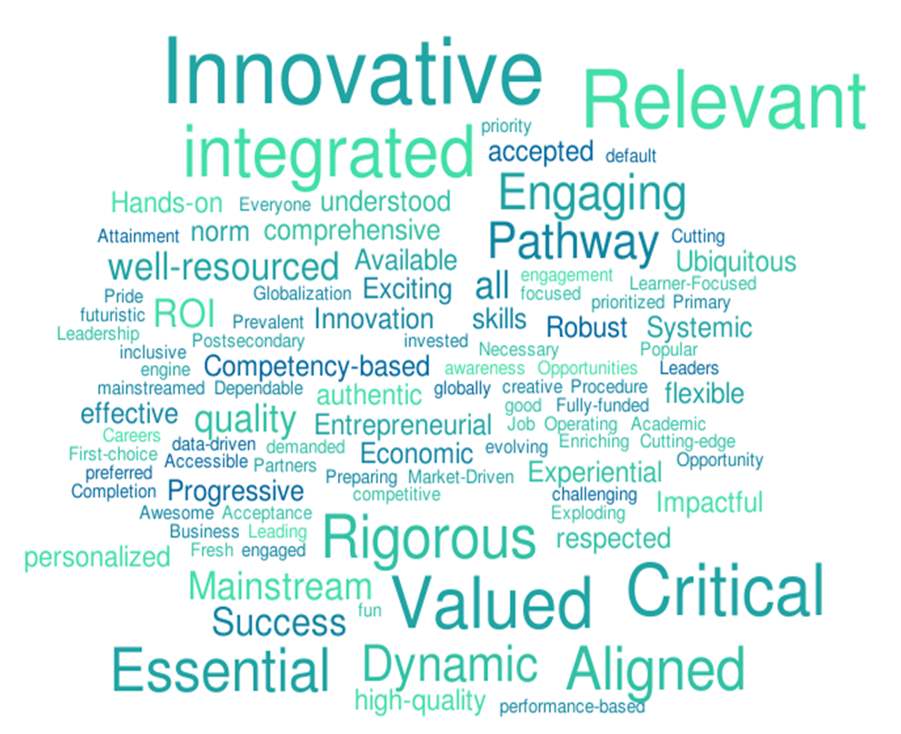
Agenda
What Is CTE?
Notes:
CTE serves [share state/local enrollment data: numbers of learners across secondary, postsecondary and adult CTE].
For example, [share a brief description of some secondary, postsecondary and adult CTE programs in your state/local area including information about their employer partnerships; options for students such as work-based learning, early postsecondary opportunities, etc.; and student outcome data].

Slide 6
Why CTE Needs Double the Investment
Notes:
Now, let me tell you why I think increasing funding for CTE is so important in Virginia and the country.

Slide 7
Agenda
CTE Delivers Real Results
Sample Data Points — use your own data from your state/community:
Students involved in CTE are far less likely to drop out of high school than other students, a difference estimated to save the economy $168 billion each year
In Virginia, CTE students’ graduation rate is 97 percent, 11 percentage points higher than non-CTE concentrators
In Virginia, 48 percent or more of CTE completers graduated with an Advanced Studies Diploma
86% of adults concentrating in CTE either continued their education or were employed within six months of completing their program
Notes:
Across the country and Virginia, CTE programs are preparing learners for promising careers and giving employers and our economy a competitive edge.
[Provide data points from your state/local area that showcase how CTE programs are delivering real results.]

Slide 8
Agenda
CTE Can Do More With
More Resources
SAMPLE QUOTE:
“Doubling the investment for CTE would provide advanced opportunities for students to expand their access to field-based experiences, hands-on classroom instructional materials and work-based learning stations, work-based internships, and quality professional development for CTE teachers and administrators. It takes a team to teach, as it takes a team to learn. CTE must be more than an elective, it must be a pathway to a career choice.” — Sandra Clement, Foy H. Moody High School
Notes:
Across the country, CTE programs are preparing learners for promising careers and giving employers and our economy a competitive edge.
[Provide data points from your state/local area that showcase how CTE programs are delivering real results.]

Slide 9


Agenda
Increased Investment =
Better Results
Notes:
Expanding funding for CTE programs will create a brighter future for our community — leading to more career options for learners, better results for employers, and increased growth for our economy.
[Tell a story about how increasing the investment in CTE will affect your state/local area in terms of options for learners, benefits to employers and economic growth. Use School Quality Data, Virginia ACTE Fact Sheet data. Note: If you’re presenting to an audience with multiple states represented, some national examples are listed below:
91 percent of parents of students in CTE believe their child is getting a leg up on their career, compared to only 44 percent of parents with children not involved in CTE.
The estimated impact of a 90 percent graduation rate nationwide (calculated for the class of 2015) is a $5.7 billion increase in economic growth and $664 million in additional federal, state and local taxes.]

Slide 10

Agenda
What Is the Campaign?
A signature campaign focused on employers
Shows Congress and the Virginia General Assembly the breadth and depth of support for CTE
Notes:
We’re asking employers to sign on to support doubling the federal investment in CTE. Employers are a central stakeholder in the CTE system and a key voice that Congress wants to hear from.
The statement of support encompasses the ideas we just discussed — how CTE delivers for learners, employers and the economy; the benefits of expanding funding; and most importantly, support for doubling the federal investment in CTE.
Advance CTE, a group that represents state CTE leaders, will share the signatures collected from employers with Congress. The aggregate data about the employers’ states, industries and size will be a critical component to demonstrating the demand for CTE from employers and building support for CTE among members of Congress.

Slide 11
How to Get Involved in the Campaign
Notes:
You can get involved today in the campaign to double the federal and state investment in CTE!
There are three ways to make difference — let’s dive into each one.

Slide 12

Agenda
Step 1: Sign On
Visit www.ISupportCTE.org to sign your company or organization on to support doubling the investment in CTE
Notes:
The first step is to sign your company or organization on to the statement that supports doubling the investment in CTE by visiting www.ISupportCTE.org.
The signatures collected from supportive companies and organizations will be critical to building visibility and support for CTE with members of Congress and Virginia’s General Assembly, who decide each year how much to invest in CTE.
Every company and organization that signs on provides one more proof point to Congress and the General Assembly that the time is now to increase the federal investment in CTE!

Slide 13


Agenda
Step 2: Stay Involved in
the Campaign
When you sign on to the statement of support, you can choose to:
  Upload your logo
  Submit a story about the impact of CTE
  Become a spokesperson for the campaign
Notes:
When you sign on to the statement of support, you can select the way(s) in which you’d like to stay involved in the campaign. You can:
Upload your organization’s logo to be used in materials supporting the campaign;
Submit a story about the impact of CTE to be featured in campaign materials; and
Become a spokesperson for the campaign and ask other employers to support the campaign.

Slide 14

Agenda
Step 3: Spread the Word
Encourage employers to sign on: www.ISupportCTE.org
Promote with your networks: Visit the Share page on www.ISupportCTE.org
Engage on social media: #ISupportCTE @CTEWorks
Notes:
The next step is to invite other employers to sign on to support doubling the investment in CTE. They can visit www.ISupportCTE.org to do so.
If you need help or ideas about how to promote the campaign, you can find sample tweets, newsletter text and more on the Share page on www.ISupportCTE.org.
You can also follow the campaign and share your support on social media by using the hashtag #ISupportCTE and tagging @CTEWorks.

Slide 15
Questions?
Notes:
Be sure to allow some time for the audience to ask you questions about the information presented.

Slide 16
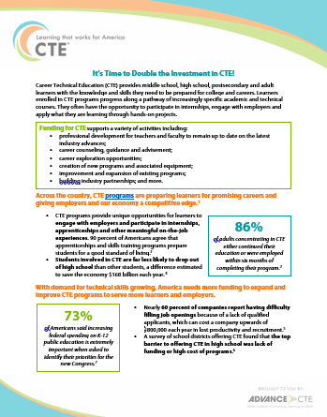
Agenda
Where Can I Find Resources and More Information?
Visit www.ISupportCTE.org to:
  Learn more about CTE
  Find resources for sharing the campaign
  Sign on to support the campaign
Notes:
The website www.ISupportCTE.org has additional information about CTE, resources such as one-pagers and promotional toolkits for sharing the campaign, and the online form to sign on to support the campaign.

Slide 17
Agenda
Thank you!
Your name
Title, Organization
Your email
www.ISupportCTE.org
#ISupportCTE
Notes:
Thank the audience for their time and support of the campaign.
Let the audience know how they can get in touch with you after the presentation.

